Slide 1


Norms and Regulations for Writing scientific Project for students in the fourth stage Prepared by Dr. Haider Haddad computer Dept. College of Science Salahadin University

Slide 2

Norms and Regulations
for Writing Scientific Project
Google Confidential and Proprietary

Slide 3

Project Writing System
Note : Use the word “project” within this system
Paper : The project uses white paper measurement A.4
Language : English is used for writing graduation projects in the Department of Computer Science & Information Technology as it is a modern science whose references are almost exclusively English
Number of pages the scientific project should be between 20-40 pages
The margins in the pages leave the following spaces from the edges of the sheet : From the top 2.5 Cm ) And from the bottom ( 2.5 Cm ) And from the right 3 Cm ) From left 2 Cm ) .

Slide 4
Regulations for Writing
1- The recommended software is MICROSOFT word
2- The project prints so that the distance between the line and the line that follows is only one (One Space ) While the distance (One and half Space ) of the titles are between the paragraphs As well as the paper of dedicated to and Supervisor Certification and List of Content and lists of tables , drawings , shapes, abbreviations, symbols and references .

Slide 5
Regulations for Writing
3- The same font type is used to write the main text of the project : (English: Times New Romans, size14 )
Font size of project title : size 24 bold.
Student and supervisor names: size 16 bold
Main title : size 16 bold.
All other text title size: 14

Slide 6
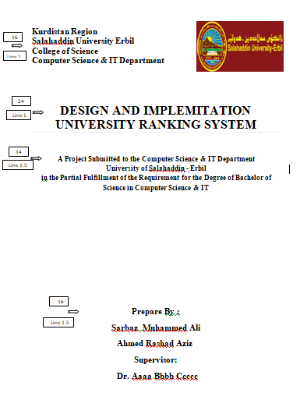
Regulations for Writing

Slide 7
Regulations for Writing
4- Abbreviations:
Use of abbreviations of scientific terms is permitted Within the text after it has used its full text for the first time and that these abbreviations appear in a separate list that refers to the abbreviation and its scientific terminology .
5- Computer programs
Sometimes a software program is required to be included in the project body and that the printing of the programs must be clear .

Slide 8
Regulations for Writing
6- page numbering
6.1 Use Greek numbering for pre-project pages ( I, II, III,IV, ... )
Arabic numbering is used ( 1 , 2 , 3 , ...) from the beginning of the project chapters . The pages of each attachment are numbered in sequence with serial numbers associated with a sequential alphabet that denotes each attachment : (A1, A2, A3, ...) .
6.2 Write down the page number at the bottom of the page and at the middle and at the height ( 2 Cm ) from the underside of the paper .

Slide 9
Regulations for Writing
7- Tables
The tables are provided so that each table has a title and a serial number linked to the chapter that contains it and the address is written at the top of the table ( eg : Table 2.7 To indicate a table number 7 In chapter no 2 )
8- Graphics and images
The forms, drawings and images shall be treated as is the case in Table (1- 7 ) , The address is written at the bottom of the figure and the following word is used to refer to it (5 - 3) Fig
To indicate the figure 5 In chapter no 3 ).

Slide 10
Regulations for Writing
9- Project Sections
The project consists of chapters divided in to sections. The number of these chapters is not specific and depends on the nature of the project. The chapters or sections are numbered sequentially . Within a single chapter or section, the parts are serialized for the chapter number or main section, for example : Chapter One CHAPTER 1 Part 1.1 This rule applies to parts of parts and so on .

Slide 11
Regulations for Writing
10- Writing language
Use English to write All parts of the project in the same language and also a summary of the project is written in Kurdish . This summary is on a separate page preceding the text of the project .
11- Copy the project
Two copies submitted to the department should not contain any errors.

Slide 12
The sequence of Pages:
1- The Title Page.
2- Dedication.
3- Certification of the supervisor.
4- Contents list.
5 - List of tables
6- List of graphics and shapes
7- List of abbreviations used
8- Abstract in English
9 - Project chapters
Chapter One –Introduction.
Chapter two- Methodology.
Chapter Three - analysis and design.
Chapter Four - Conclusion and Recommendations
11- Appendix
12- References.
13- پوختە

Slide 13
Thank You

